Slide 1
Capstone Project -3
Bank Marketing Effectiveness Prediction
Tushar Gautam

Slide 2


Contents
Problem Statement
Data Summary
Exploratory Data Analysis
Feature Engineering
Encoding categorical features
Sampling and feature scaling
Model Training
Model performance
Challenges
Conclusion

Slide 3


Problem Statement
The data is related with direct marketing campaigns (phone calls) of a Portuguese banking institution. The marketing campaigns were based on phone calls. Often, more than one contact to the same client was required, in order to access if the product (bank term deposit) would be ('yes') or not ('no') subscribed. The classification goal is to predict if the client will subscribe a term deposit (variable y).

Slide 4
Data Summary
Marital - (Married , Single , Divorced)
Job-(Management,BlueCollar,retired etc)
Contact -(Telephone,Cellular,Unknown)
Education (Primary,Secondary,Tertiary)
Month-(Jan,Feb,Mar,Apr,May etc)
Poutcome -(Success, Failure, Other, Unknown of previous campaign)
Housing -(Yes/No)
Loan -(Yes/No)
Default -(Yes/No)
Age
Balance
Day
Duration
Campaign (Number of contact performed during campaign)
Pdays (Number of days passed by after the client was last contacted)
Previous (Number of contact performed before this campaign)

Slide 5
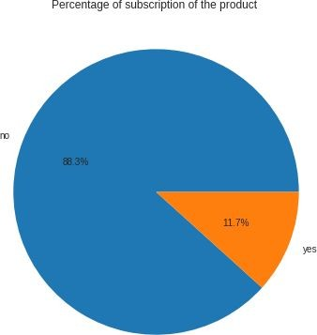
Exploratory Data Analysis
Target variable distribution
The target variable ‘y’ tells us the outcome of the campaign whether they went ahead for
the term deposit or not.
Out of 45211 only 5289 people subscribed to the term deposit.

Slide 6
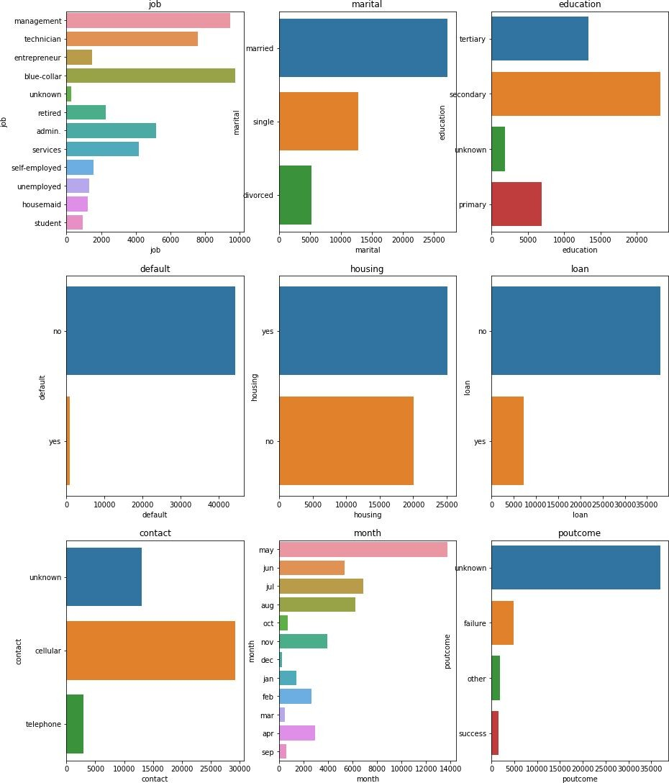
categorical features

Slide 7
Inference
-Management and blue collor has the highest distribution and unknown has the lowest.
-We have maximum data of married people.
-Secondary and tertiory education background clients are highest in the dataset.
Client who has no credit in default is maximum and who has is very low near to 1 %.
-Client with no personal loan are more in dataset.
-Previous outcome is unknown in maximum cases might be the because there was no proper reason given for the same.
-We have maximum data available for the month of may,june,july and august.
-Y which is our target variable we can see there are more no results than yes. As it is classification problem and we have class imbalance which is the problem we have to solve this class imbalance before training model.

Slide 8
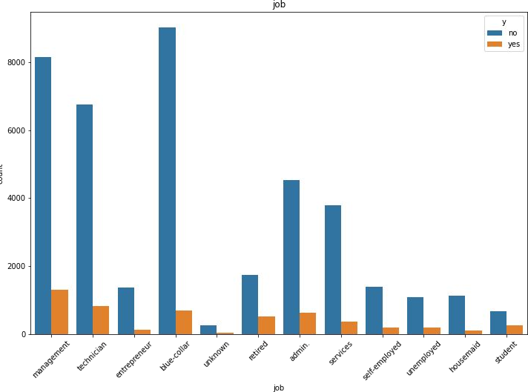
Relationship between categorical feature and Target Variable
People with management jobs have the most number of term deposit

Slide 9
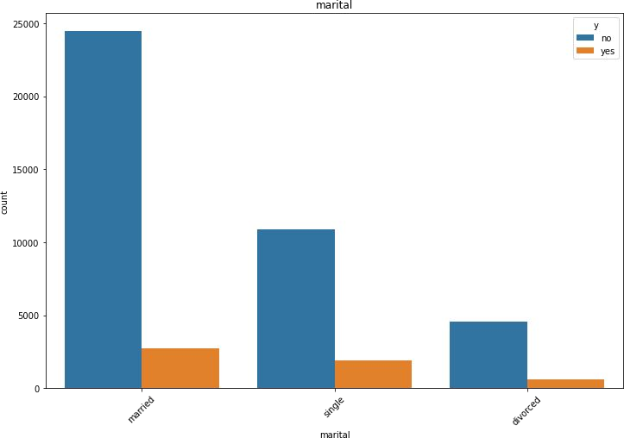
Marital status v/s target variable
clients who has Married and single seems to be more interested on term deposit.

Slide 10
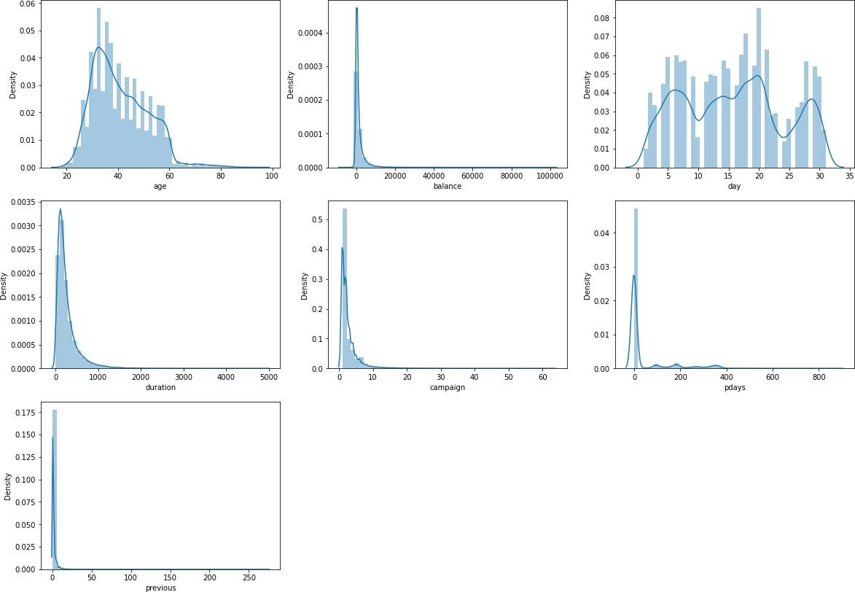
Numerical Features
There are 7 Numerical Features.
It seems age and days are kind of normally distributed.
Balance, Duration, Campaign, pdays and previous are positively skewed.

Slide 11
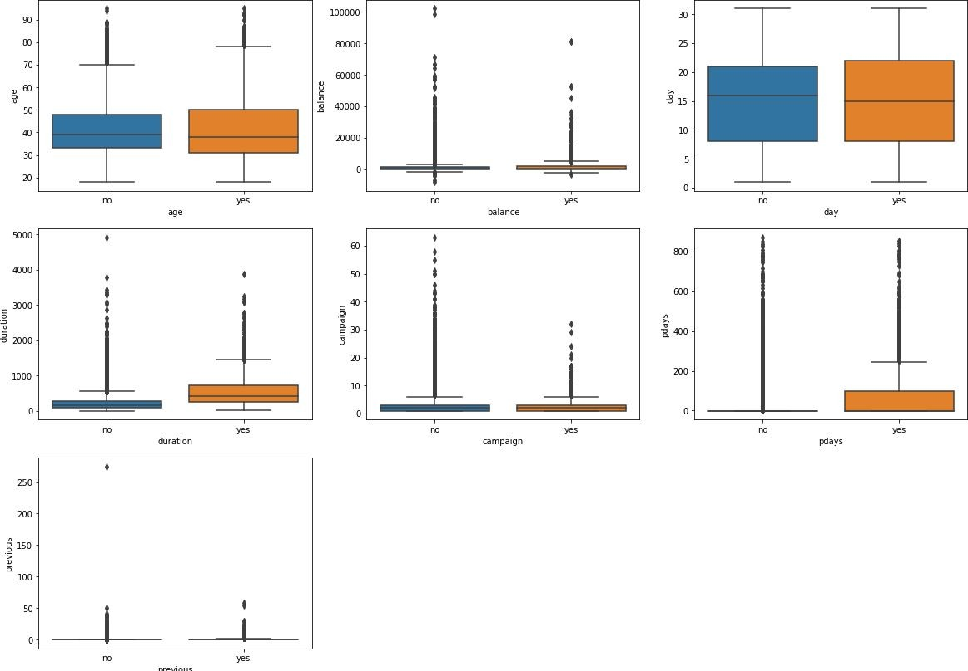
Relation between Numerical feature and Target Variable
Age distribution in dataset, shows that campaign is more centered to 30-50 age group.
client shows interest on term deposit, who had discussion for longer duration.

Slide 12
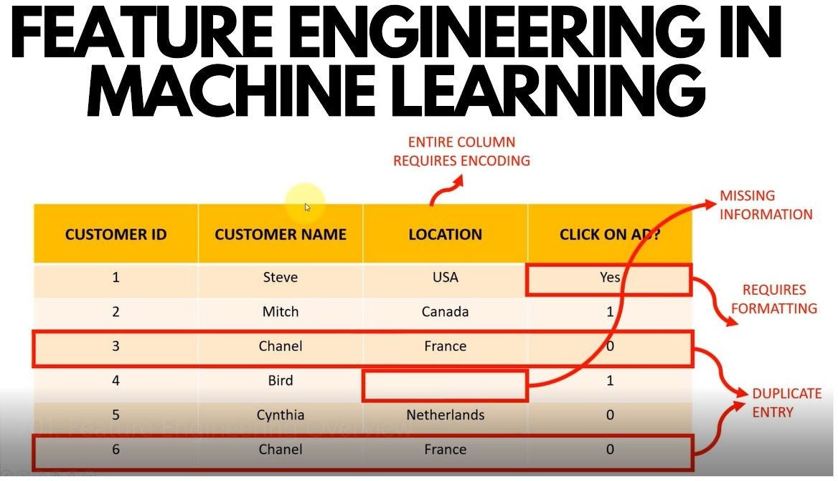
Feature Engineering
Feature Engineering is a machine learning technique that leverages data to create new variable that aren’t in the training set . We produce new features with the goal of simplifying and speeding up data transformation while also enhancing model accuracy.

Slide 13
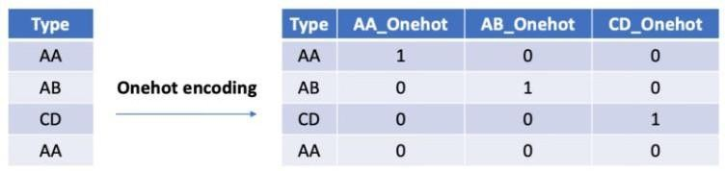
Encoding categorical variables
In simple words encoding means converting data into required format. Since ML models takes only numerical data to do computation we will convert all cat variable into numerical data.
We used two methods to encode data.
Label Encoding: Label Encoding refers to converting labels to numeric form.
One Hot Encoding: It is also the process of converting categorical data into numerical data but here we don’t give
labels to each category instead we create new columns for each category and gives binary values.

Slide 14
Sampling
The dataset was highly imbalance so to balance the dataset, we used technique called Random over sampler.
Oversampling can be defined as adding more copies to the minority class.
Feature Scaling
Feature Scaling is a technique to normalize/standardize the independent features present in the dataset in a fixed range.
We used MinMaxScaler to scale feature ,it basically takes min and max value of column and scale feature according to that in range of 0 to 1

Slide 15
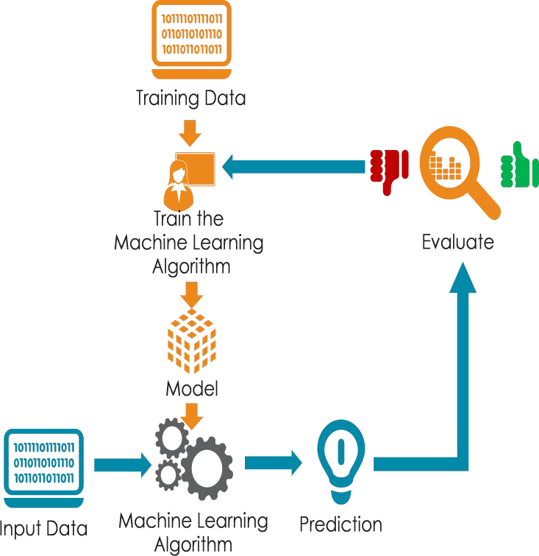
Model Training
Model training is the process of fitting a data into machine learning model from which model learns the patterns in data to predict the dependent variable. Model do it so by assigning a weight to each variable.
After our model is trained we test our model on test data to check how our model is performing.

Slide 16
Model
_{E}Ch_{v}oo_{a}s_{l}e_{u}th_{a}e _{t}e_{i}v_{o}alu_{n}ation metric wisely.
Accuracy is not the best metric to use when evaluating imbalanced datasets as it can be misleading.
Metrics that can provide better insight are:
Confusion Matrix: a table showing correct predictions and types of incorrect predictions.
Precision: the number of true positives divided by all positive predictions. Precision is also called Positive Predictive Value. It is a measure of a classifier’s exactness. Low precision indicates a high number of false positives.
Recall: the number of true positives divided by the number of positive values in the test data. The recall is also called Sensitivity or the True Positive Rate. It is a measure of a classifier’s completeness. Low recall indicates a high number of false negatives.
F1 Score: the weighted average of precision and recall.
Area Under ROC Curve (AUC-ROC): AUC-ROC represents the likelihood of your model distinguishing observations from two classes. In other words, if you randomly select one observation from each class, what’s the probability that your model will be able to “rank” them correctly?

Slide 17
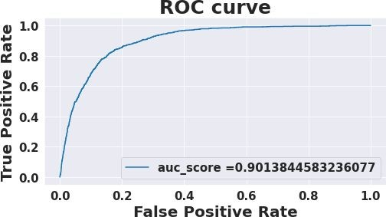
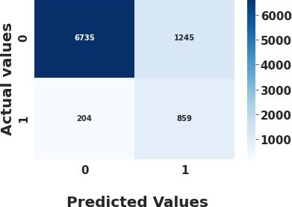
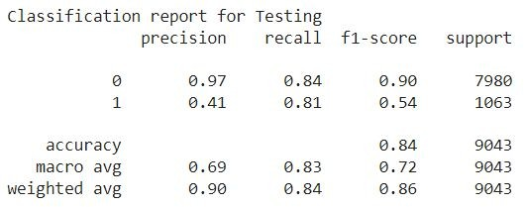
Logistic Regression

Slide 18
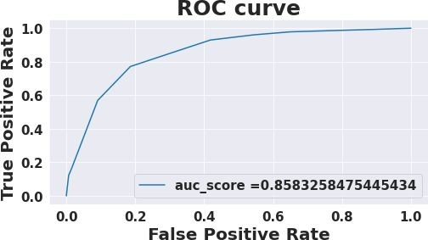
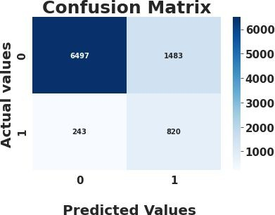
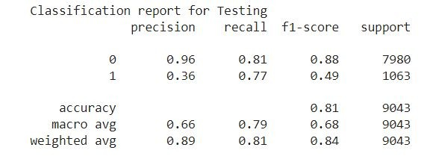

Decision Tree Classifier

Slide 19
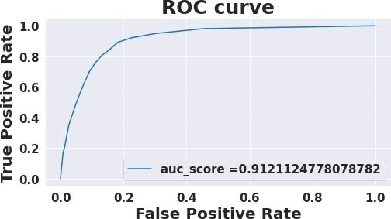
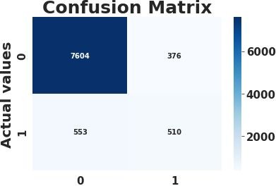
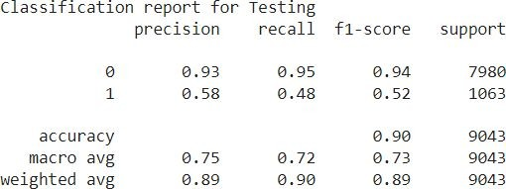

Random Forest Classifier

Slide 20
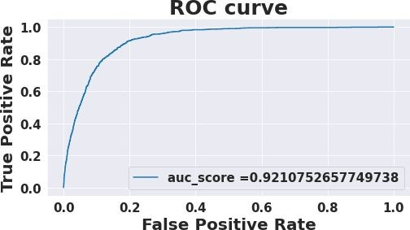
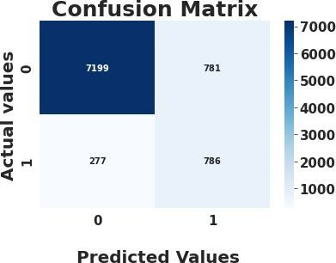
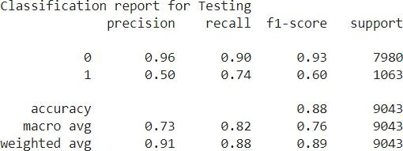

XGBoost Classifier

Slide 21
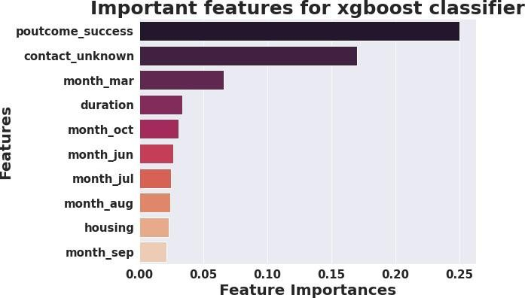
Feature Importance

Slide 22
Challenges
Feature Engineering.
Handling Class Imbalance.
Selecting feature to train model.
Model training, hyperparameter tuning and improving corrected of prediction for both category.

Slide 23
Conclusion
First we trained our model before handling class imbalance our model performed very good on 0 category and very poor for category 1.
After solving class imbalance we trained and compared performances of logistic regression, Decision Tree classifier, Random forest classifier and Xgboost classifier.
After tuning hyperparameter Xgboost model gives best performance
TP = 7199, FP=781, TN = 786 and FN=277) and we got auc score of 0.9210.

Slide 24
Thank You

